Slide 1
Information Retrieval using Inference Model and Belief Network
Presented By: Huzaifa Mumtaz

Slide 2
Inference Model
01
Inference Model: A Bayesian-based approach that computes relevance using document and query word frequencies. It evaluates the likelihood of a query given a document and adjusts probabilities with smoothing for missing terms.

Slide 3
Interference Model
Inference Model Example:
Query: "artificial intelligence"
Document: "Artificial intelligence is revolutionizing technology"
Step: The model computes the probability of the document and query terms, such as "artificial" and "intelligence," based on their frequencies. It then calculates the relevance score, adjusting for any missing or rare terms, and ranks the document accordingly.

Slide 4
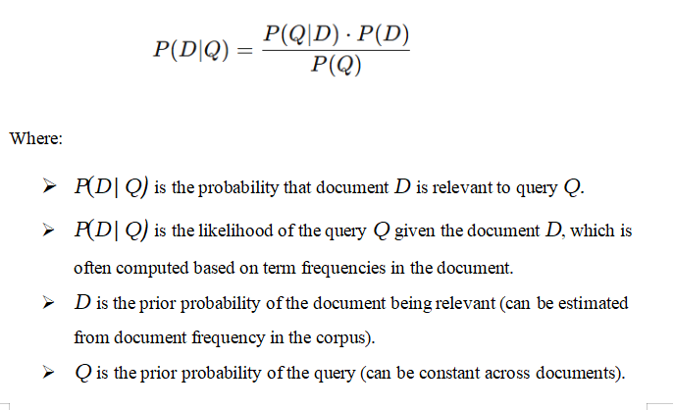
Relevant Formulas

Slide 5
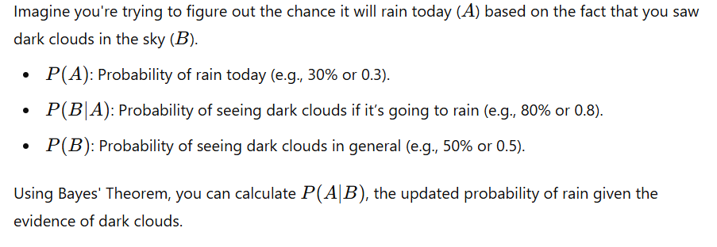
Formula Explanation

Slide 6
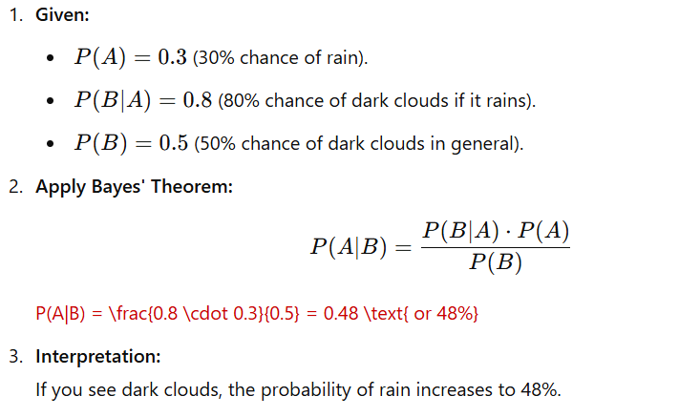
Formula Explanation

Slide 7
Belief Network
Belief Network: A probabilistic model that calculates relevance by estimating conditional probabilities. It considers the presence of query terms in a document and simulates a network connecting query terms, document terms, and relevance.

Slide 8
Belief Network
Belief Network Example:
Query: "data science"
Document: "Data science and machine learning"
Step: The model calculates the probability of "data" and "science" appearing in the document. It finds both words in the document and computes a relevance score based on their presence, yielding a high relevance score due to the overlap.

Slide 9
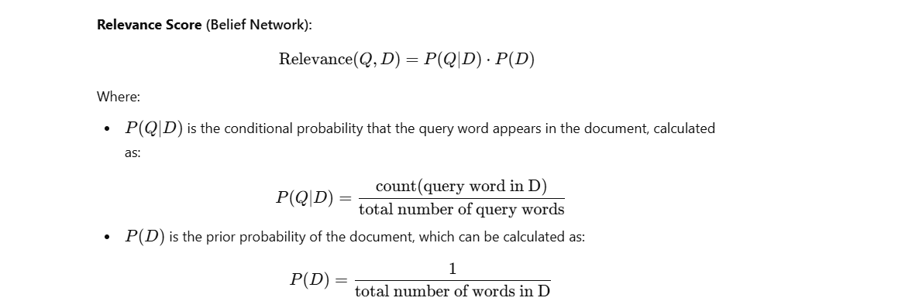
Formulas

Slide 10
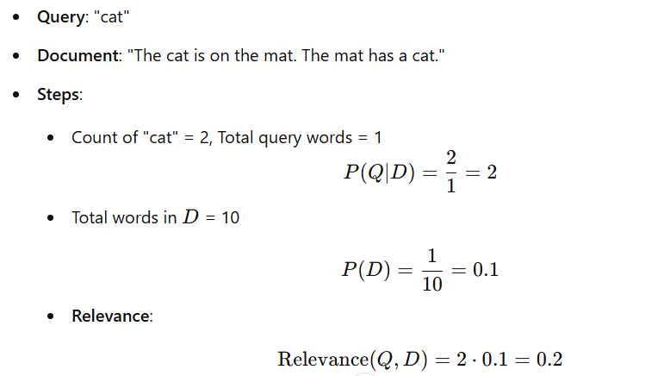
Formula Explanation

Slide 11
Key Features
Probabilistic Models: Use of the Inference Model and Belief Network for document retrieval.
Relevance Calculation: Accurate scoring based on word frequencies and query-document relationships.
Automated Model Selection: Dynamic selection of the best model based on query length and performance.
Ranking System: Efficient document ranking using computed relevance scores.
Adaptability: Tailored performance for both simple and complex queries.
Optimization: Use of smoothing and heuristics to handle missing or rare words.
Comparative Analysis: Detailed evaluation of models with query-specific results.
These features highlight the system's functionality and strengths effectively.

Slide 12
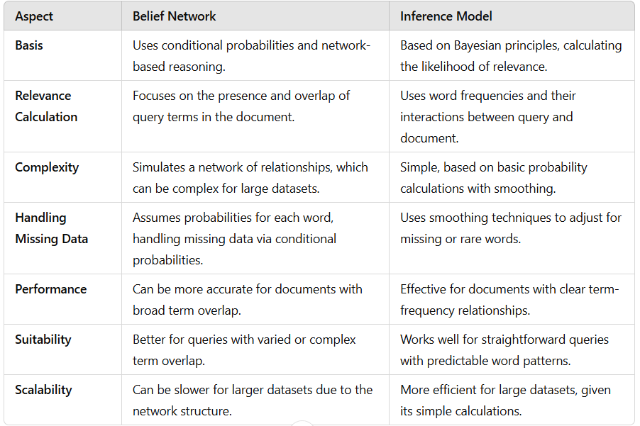
Comparison

Slide 13
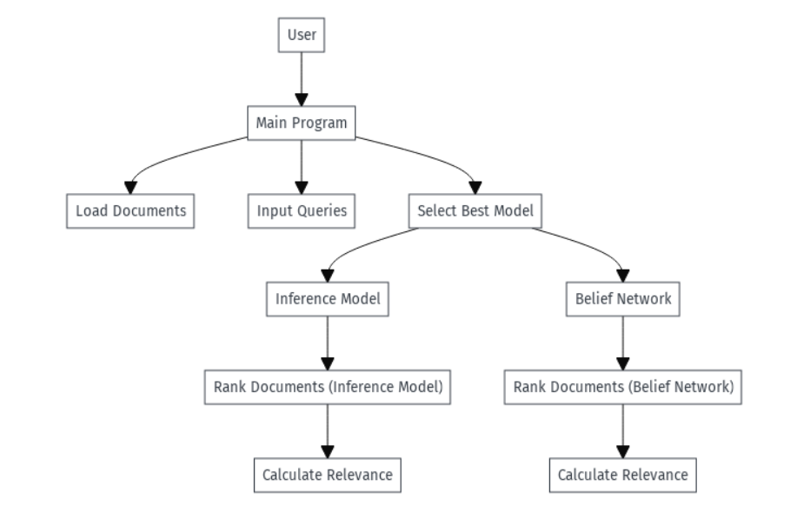
Data Flow Diagram

Slide 14
Thank You

